Slide 1

JavaScript Applications
Course Overview
SoftUni Team
Technical Trainers
Software University
https://softuni.bg

Slide 2
Table of Contents
Introduction
Training & Team
Course Objectives
Course Organization

Slide 3
Have a Question?
sli.do
#js-advanced

Slide 4














SoftUni Diamond Partners

Slide 5

Educational Partners

Slide 6

JS Applications
Course Objectives & Program

Slide 7
Course Objectives
Improve DOM skills with new techniques
Use remote services to read and store data
Work with external libraries and documentation
Apply best practices and project architecture
Create fully-featured front-end applications

Slide 8
JS Applications – Course Topics
HTTP and REST Services
Asynchronous Programming
Data and Authentication
Single Page Applications
Architecture and Testing

Slide 9
JS Applications – Course Topics
Client-Side Rendering
Routing
Modular Applications
End-to-End Application
Web Components

Slide 10

Trainers and Team

Slide 11

Viktor Kostadinov
Senior technical trainer with 6 years experience in the IT field
Front-End Instructor at Amusnet Interactive
Former Head of the R&D Unit at Software University
Former Director of the Education Department
JavaScript enthusiast

Slide 12
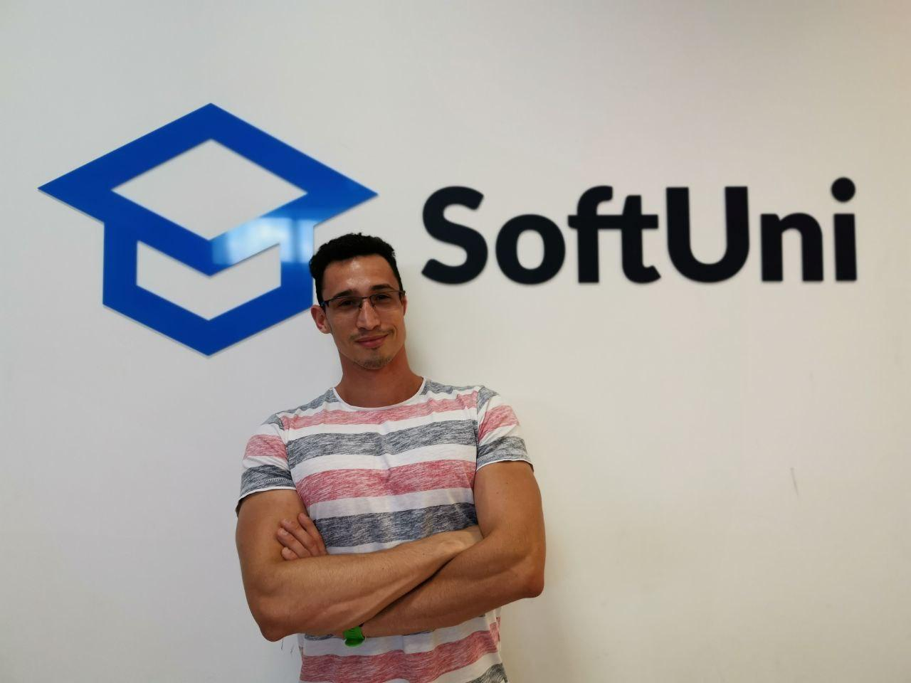
Dimitar Krastanov
3 years of experience as a Trainer at Software University
Front-End Developer at Mobile Wave Solutions
Interests in Full Stack Development
Experience with JS, ReactJS, TypeScript

Slide 13

Course Details
Assessment and Schedule

Slide 14

Practical Exam
Structure: 1 problem for 4 hours
Single Page Application with multiple features
Use remote data storage
Implement user profiles
Libraries for templating and routing
Exam: 1 Apr 2023
Retake: 11 Apr 2023
Link to Exams

Slide 15
Theoretical Exam
20 questions for 30 minutes
Multiple-choice
English
Automated quiz system
Available online
You can submit your answers just one time

Slide 16
JS Advanced Module Timeline
COMPLETED
JS Advanced
Start: 10. Jan 2023
Exam: 18. Feb 2023
10.
18.
6 weeks
4 times per week
Jan
Feb
JS Applications
Start: 21. Feb 2023
Exam: 01. Apr 2023
21.
01.
6 weeks
4 times per week
Feb
Mar
Apr
Exam Retakes
JS Advanced: 5. Apr 2023
JS Applications: 11. Apr 2023
Apr

Slide 17
Course Scoring
Practice grade:
Theory grade:
SoftUni Certificate: 5.00 from Practice
CPE Certificate: 3.00 average from Practice + Theory
Practical Exam
Homework
100 %
+5 %
Theoretical Exam
100 %
17

Slide 18


Learn to Search in Internet
The course assignments require to search in Internet
This is an important part of the learning process
Some exercises intentionally have no hints
Learn to find solutions!
Software development includes everyday searching and learning
No excuses, just learn to study!
Developers learn new technologies, tools, languages every day!

Slide 19




Course Web Site, Forum and FB Group
Official web site:
Official discussion forum:
Official Facebook group:
Official SoftUni JavaScript Community:
softuni.bg/trainings/3962/js-applications-february-2023
softuni.bg/forum/categories/19/
facebook.com/groups/JsAdvancedJanuary2023
facebook.com/groups/SoftUniJavaScriptCommunity/

Slide 20
Questions?
Notes:
20

Slide 21
Trainings @ Software University (SoftUni)
Software University – High-Quality Education, Profession and Job for Software Developers
softuni.bg, softuni.org
Software University Foundation
softuni.foundation
Software University @ Facebook
facebook.com/SoftwareUniversity
Software University Forums
forum.softuni.bg
Notes:
21

Slide 22

License
This course (slides, examples, demos, exercises, homework, documents, videos and other assets) is copyrighted content
Unauthorized copy, reproduction or use is illegal
© SoftUni – https://about.softuni.bg/
© Software University – https://softuni.bg
Notes:
22

